Slide 1
Lane detection presentation
By: nmnbrt

Slide 2
Introduction
During the 2nd Year End Semester break, I was presented with the golden opportunity to undergo an internship programme from 08-June-18 to 03-July-18 with Tata Consultancy Services Ltd. The experience of my first Internship programme was very fulfilling and I was able to learn a lot from my seniors over there.
Fortunately enough I was given the chance to work on “Next Generation Technologies” which was quite fruitful from a career point of view. I had a lot to gain from this programme that I am sure, would help me achieve my future endeavours.

Slide 3
Software and tools used
Ubuntu
Linux
OpenCV
C++ Language
Python Language
TCS private software
GitHub

Slide 4
Pre-project training
Unix Basics, Operational commands.
End of day evaluation
What is Computer Vision/Video Analytics
What is Machine Learning
What is a data set?
What is a Confusion Matrix? How are data sets being used for improving machine learning accuracy

Slide 5
Pre-project training (contd.)
What are some of the use-cases/applications where Computer Vision/Video Analytics is being used in industry segments Retail, Public Safety (Surveillance)
End of day evaluation
How is machine learning frameworks like Caffe, TensorFlow being used with Computer Vision
Setup a sample Video Analytics solution (and walk through the code to understand the business logic)
Present the above solution (demo) and explain how the architecture/business logic works

Slide 6
Project Description
The project that I was assigned to was “Lane Detection System”. It was a solo project that was given to me after making sure that I had appropriate knowledge about OpenCV and it’s functionalities. The main purpose of the system is to detect lanes and pathways appropriately and clearly distinguish it from the rest of the unfruitful media present in the image/video inputted to the program. The source of the media can be a saved video/photo or a live steam of frames can be captured from a video camera. There were a lot of functions/methods which were implemented in the program. Some were pre-written and some were needed to be written newly.

Slide 7
Why Lane Detection?
The self driving car market is growing at a very fast pace. Many companies are working in this problem trying to solve every aspect of it, so that autonomous cars can drive safely on the roads. It is a very complex problem due to the many aspects that it relies on: robotics, path planning, navigation, computer vision, mechanics, etc.

Slide 8
What’s Basic Idea Behind The Project?
This project is focused in the computer vision aspect of it, a crucial module. If an automated car is going to drive around unpredictable environments, it has to be able to perceive and detect every small detail that surrounds it.
By using a video feed input of a car driving on the highway, the algorithm will detect where the lane is so that the car can use its location to avoid getting out of the it. It will also be able to predict any turn on the road to secure a good tracking of the lane.

Slide 9
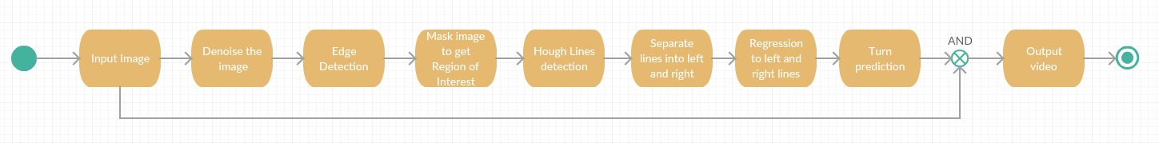
What’s The Algorithm used?

Slide 10
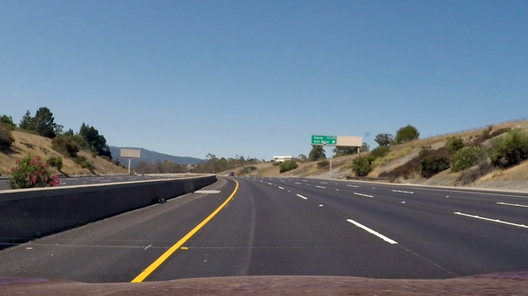
Step 0: Input Image
The frames of a video are captured. This image inputs are from a video of a car driving on the highway.

Slide 11

Step 1: Denoise The Image
The first step will be to denoise the image by applying a filter like a Gaussian mask that smooths the image and removes any undesired pixel values that could prevent the correct detection of the lanes.

Slide 12
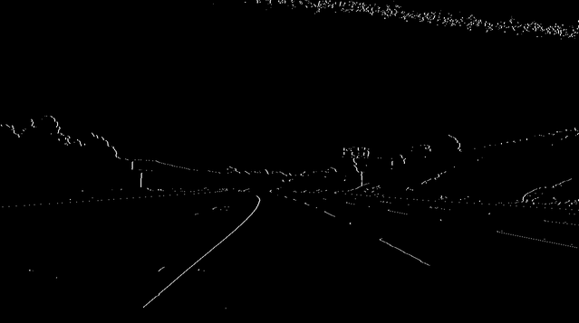
Step 2: Edge Detection
An edge detection algorithm is used to detect the lines that form the boundaries of the lanes. For this, the image has to be converted to grayscale, and then to binary. Once this is done, the edge detection is achieved by applying a row kernel [-1 0 1] to each pixel of the image.

Slide 13
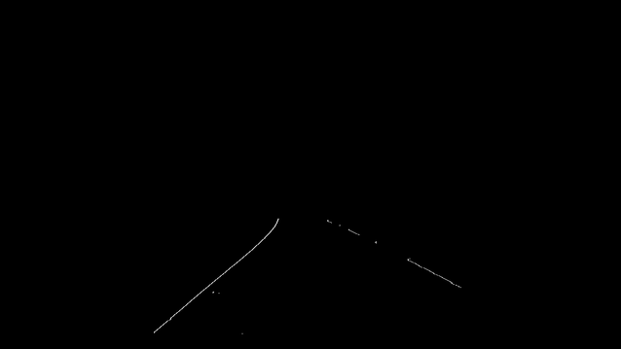
Step 3: Masking The Image
There are lots of unwanted edges being detected. To fix this, the image will be masked so that it only detects edges in a region of interest. This helps because the road is always going to be in the same location on the image.

Slide 14
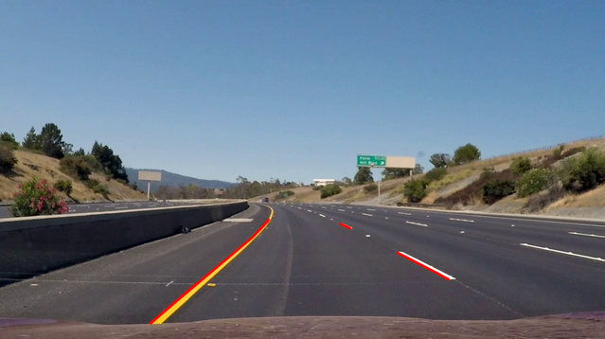
Step 4: Hough Line Detection
Once the desired edges are detected and the unwanted ones have been removed, the next step is to use the Hough Lines detection algorithm, which gives the location of all the lines in the image. The parameters of the function (rho and theta) were determined by trial and error so that only the most notable lines are detected.

Slide 15
Step 5: Separation Of Lines
By applying basic linear algebra, all the detected Hough lines will be classified as left side lines or right side lines. The lines are classified depending on the value of their slope and where their initial and final points are approximately located with respect to the centre of the image.

Slide 16
Step 6: Applying Regression
Regression will be then applied to the stored left and right lines clusters to obtain only one line for each side. To accomplish this, the least squares method is used. The initial and final points of the lines are used as the data for the regression. The resultant lines will be the corresponding lane boundaries.

Slide 17
Step 7: Turn Prediction
Lastly, the turn prediction is determined by obtaining the location of the vanishing point (formed by the lane boundary lines) with respect to the centre of the image.
Once everything is detected, the results are represented in the input frame, captured at the beginning of the algorithm.

Slide 18
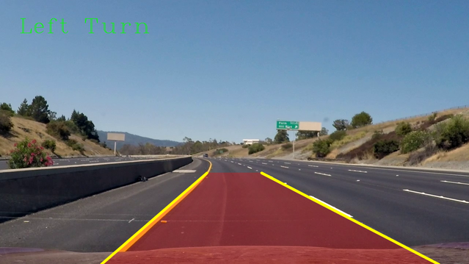
Final output

